Slide 1
CSE 260 DIGITAL LOGIC DESIGN
Khadija Rasul
Aniqua Zereen

Slide 2
Review: Try it by yourself
A car garage has a front door and one window, each of which has a sensor to detect whether it is open. A third sensor detects whether it is dark outside. A security system for the garage follows this rule: the alarm rings if the alarm switch is turned on and either the front door is not closed or it is dark and the side window is not closed. Ignore rest of the condition.

Slide 3
Solution
SwitchOn | Door | Window | Dark | AlarmRing
0 | 0 | 0 | 0 | x
0 | 0 | 0 | 1 | x
0 | 0 | 1 | 0 | x
0 | 0 | 1 | 1 | x
0 | 1 | 0 | 0 | x
0 | 1 | 0 | 1 | x
0 | 1 | 1 | 0 | x
0 | 1 | 1 | 1 | x
1 | 0 | 0 | 0 | 0
1 | 0 | 0 | 1 | 0
1 | 0 | 1 | 0 | 0
1 | 0 | 1 | 1 | 1
1 | 1 | 0 | 0 | 0
1 | 1 | 0 | 1 | 0
1 | 1 | 1 | 0 | 1
1 | 1 | 1 | 1 | 1
WDk
SDr
X
X
X
X
X
X
X
X
0
0
1
1
0
0
1
0
AlarmRing=WDk+WDr

Slide 4
Try it by yourself
Harvard university wants to offer a course on robotics. Depending on your qualification you can either do it in BRACU campus or go to USA Harvard campus fully financed. The criteria for enrolling in this course are
You have passed the course Digital Logic with an ‘A’.
You are a full time BRACU undergraduate student
You are not on probation
You are a full time CSE student
Let us assume there cannot be a full time BRAC U undergrad student who is on probation and still managed A in Digital logic course.
If u satisfy condition (a),(b),( c) and (d) -> you get to do it in Harvard. Else if you don’t satisfy (b) and (d) but satisfy (a) and ( c) , take this course in BRACU campus.
Now find out the equation for BRACU campus and for Harvard campus

Slide 5
A=1: Got A in Digital Logics
B=1: Full time bracu undergrad
C=0: You are on probation
D=1: You are full time CSE undergraduate
A Got ‘A’ | B FT BU Grad | C Not on probation | D FT CSE | Harvard | BRACU
0 | 0 | 0 | 0 | 0 | 0
0 | 0 | 0 | 1 | 0 | 0
0 | 0 | 1 | 0 | 0 | 0
0 | 0 | 1 | 1 | 0 | 0
0 | 1 | 0 | 0 | 0 | 0
0 | 1 | 0 | 1 | 0 | 0
0 | 1 | 1 | 0 | 0 | 0
0 | 1 | 1 | 1 | 0 | 0
1 | 0 | 0 | 0 | x | x
1 | 0 | 0 | 1 | x | x
1 | 0 | 1 | 0 | 0 | 1
1 | 0 | 1 | 1 | 0 | 0
1 | 1 | 0 | 0 | 0 | 0
1 | 1 | 0 | 1 | 0 | 0
1 | 1 | 1 | 0 | 0 | 0
1 | 1 | 1 | 1 | 1 | 0
CD
AB
0
0
0
0
0
0
0
0
0
0
1
0
x
x
0
0
Harvard=ABCD
CD
AB
0
0
0
0
0
0
0
0
0
0
0
0
BRACU=AB’D’
x
x
0
1

Slide 6
Even and odd Parity

Slide 7
‘0’ means correct, ‘1’ means wrong!
When we send binary data we need to count the number of 1s that are present in it. For example sending the ASCII character 'B' 1000010. This has two occurrences of 1. We can then apply another bit to the front of it and send it across the internet.
If we are using even parity 01000010
If we are using odd parity 11000010
Now when the data gets to the other end and we were using even parity
01001010 - odd parity, there has been an error in transmission, ask for data to be sent again
01000010 - even parity, the data has been sent correctly

Slide 8
Try and apply the correct parity bit to the following:
_1011010 (even parity)
_1011010 (odd parity)
_1111110 (even parity)
_0000000 (odd parity)
‘0’ means correct, ‘1’ means wrong!

Slide 9
Solution
01011010
11011010
01111110
10000000

Slide 10
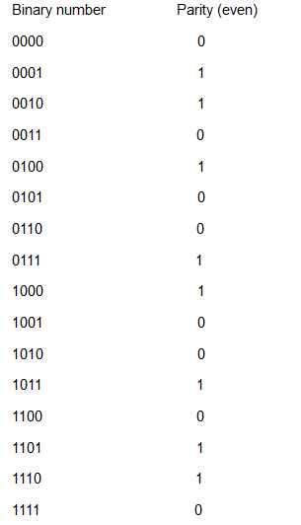
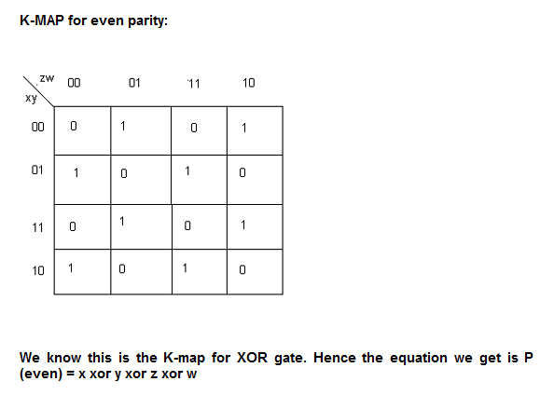

Slide 11
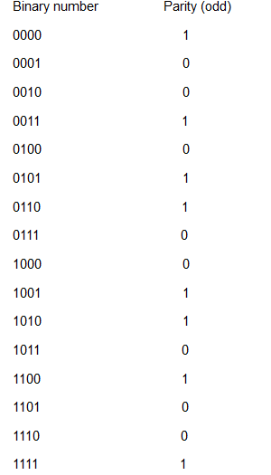
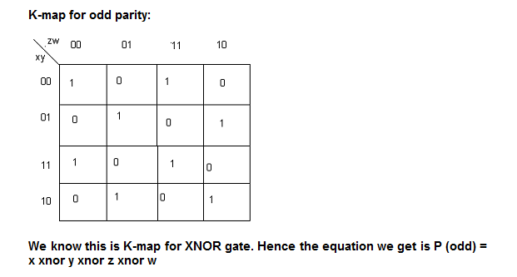

Slide 12
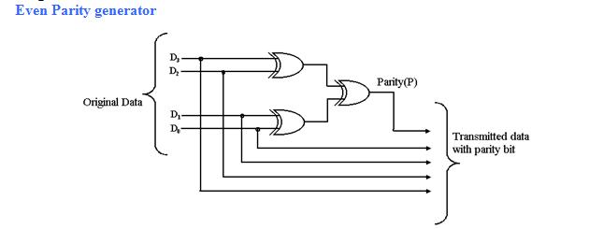
Even parity generator

Slide 13
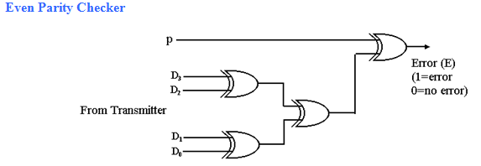
Even Parity checker

